Slide 1

BMS INSTITUTE OF TECHNOLOGY & MANAGEMENT
DEPARTMENT OF CSE
Technical Seminar On
“Web Archiving Fixity Verification Framework”
Presented by:
Likith S
1BY18CS081
Dept of CSE
Under the guidance of:
Mrs. Durga Bhavani A
Assistant Professor, CSE
Dept of CSE

Slide 2
TABLE OF CONTENTS
Introduction
01
04
System Model
02
05
Problem Statement
Result Analysis
03
06
Literature Survey
Conclusion

Slide 3
Introduction
Web Archiving and Fixity

Slide 4
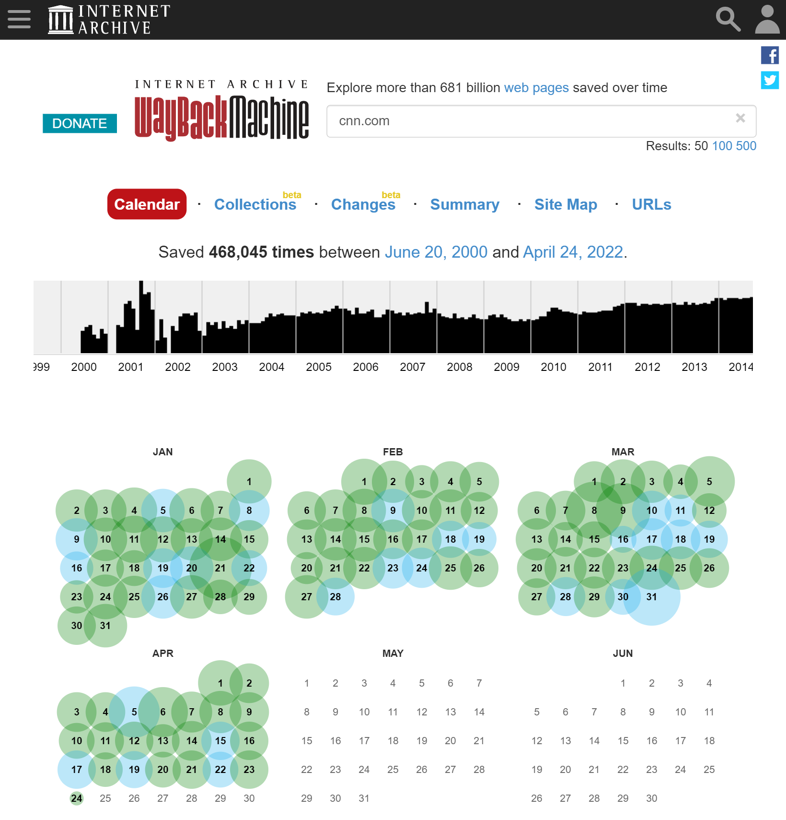
Web Archiving
Fixity
❏ Web archiving is the process of collecting portions of the World Wide Web, preserving the collections in an archival format, and then serving the archives for access and use.
❏ Fixity is checked to ensure an archived resource has remained unaltered since the time it was captured.

Slide 5
❏ Web archives capture and archive the web to allow access to prior states of web resources. The archived content delivered by such archives cannot be blindly trusted, we should consider the question of validity and authenticity.
❏ One potential solution to that is to generate a cryptographic hash value on the HTML content of an archived web page, or memento.
Fig: CURL command downloads the raw HTML code of the memento then the hashing function sha256sum generates a SHA-256 hash on this downloaded code. By running these commands at different times we should always expect to obtain the same hash.

Slide 6
Problem Statement
To develop fixity calculation framework with two approaches, namely Atomic and Block, to establish and check fixity of archived resources

Slide 7
Literature Survey

Slide 8
[1] Ada Lerner, Tadayoshi Kohno, and Franziska Roesner. 2017. Rewriting History:Changing the Archived Web from the Present. In Proceedings of the 16th ACM conference on Computer and Communications Security (CCS), 1741–1755.
Problem: Vulnerabilities discovered in Internet Archive’s Wayback Machine:
❏ Archive-Escapes
❏ Same-Origin Escapes
❏ Anachronism-Injection
Solution: Defenses to prevent abusing vulnerabilities:
❏ Modify/Analyze Javascript to Prevent Escapes
❏ Serve Distinct Archived Domains from Distinct Subdomains
❏ Browser Extensions to Block/Highlight Escapes

Slide 9
[2] Tobias Kuhn and Michel Dumontier. 2014. Trusty URIs: Verifiable,
immutable, and permanent digital artifacts for linked data. In
European Semantic Web Conference. Springer, 395–410.
Problem: Issues, such as reconstructing archived web pages, caching, dynamic/randomly-generated content, illustrate how difficult it is to generate repeatable fixity information.
Solution: A modular approach, where different modules handle different kinds of content on different conceptual levels of abstraction, from byte level to high-level formalisms.

Slide 10
[3] David Rosenthal, Thomas Robertson, Tom Lipkis, Vicky Reich, and Seth Morabito, 2005. Requirements for Digital Preservation Systems. D-Lib Magazine 11, 11 (2005).
Problem: Threats against the content of digital preservation systems. The designers of archives must be aware of threats, such as media failure, hardware failure, software failure, communication errors, failure of network services.
Solution: These requirements derived top-down by presenting an alternate, bottom-up view of the field.

Slide 11
[4] John A. Berlin. 2018. To Relive the Web: A Framework for the Transformation and Archival Replay of Web Pages. Master’s thesis. Old Dominion University. https://doi.org/10.25777/n8mg-da06.
Problem: Requires web archives to modify the page and its embedded resources, so that they no longer reference the original server they were archived from but back to the archive.
Solution: Evaluate the effectiveness of using a generated client-side rewriting library to augment the existing replay systems of web archives by crawling mementos.

Slide 12
System Model
Manifest generation, atomic
and block dissemination,
verifying fixity...

Slide 13
Fixity Verification of Mementos
Fixity Verification of Mementos
3) Generating manifests of
the current state and
comparing them with their
corresponding previously
archived versions
1) Generating manifests for mementos
2) Disseminating those
manifests into
different web archives

Slide 14
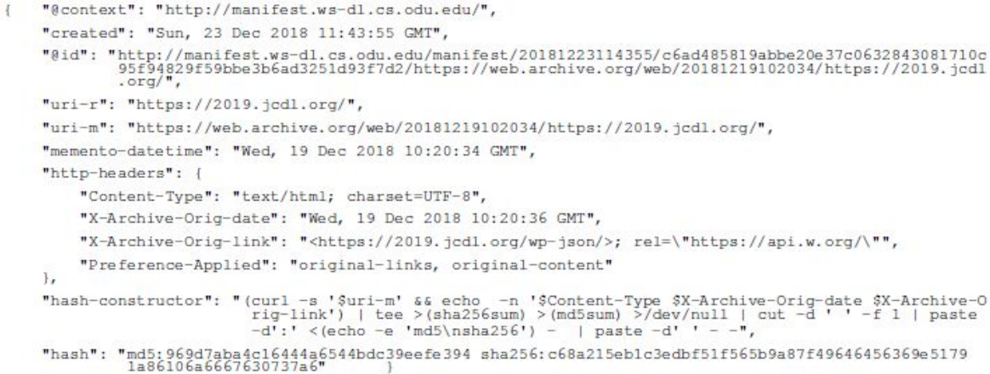
1. MANIFEST GENERATION
A manifest (identified by URI-Manif) consists of metadata summarizing fixity information of a memento as shown in the figure below.

Slide 15
2.1 Atomic Dissemination
❏ Each memento that should have at least one corresponding manifest file containing fixity information of the memento.
❏ It stores the fixity information of a memento in different archives in addition to the archive in which the memento is preserved.
Disseminating manifests can be archived through four steps:
1. Push a web page into one or more archives.
2. Generate a manifest by computing the fixity information of the memento.
3. Publish the manifest at a well-known location, URI-Manif.
4. Disseminate the published manifest in multiple archives. This will generate archived manifests, URI-M-Manif.

Slide 16
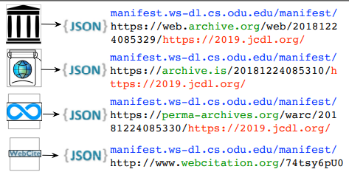
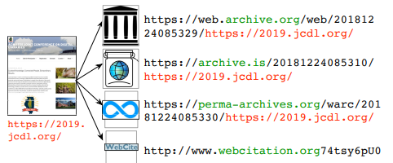
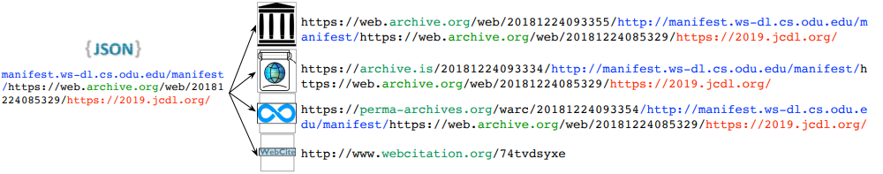
Fig: A web page is pushed into multiple archives
Fig: Compute fixity and publish it on the web
Fig: Push the fixity information into multiple archives

Slide 17
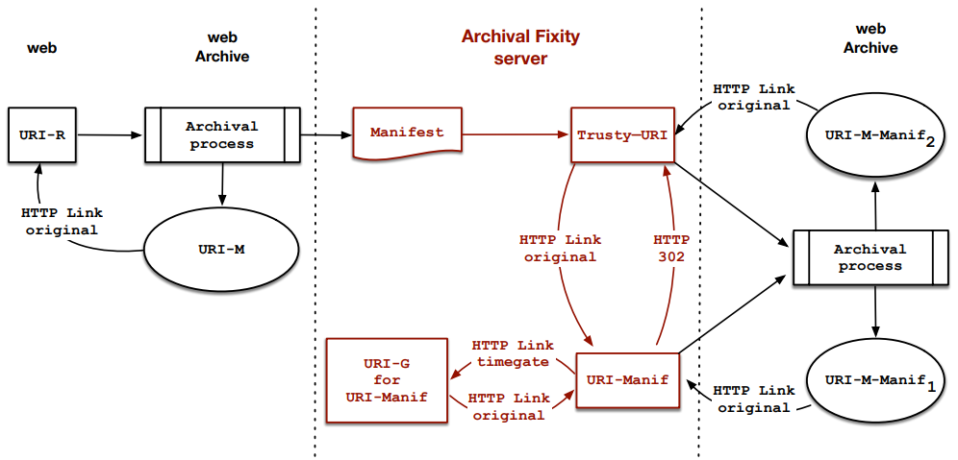
Fig: The Atomic approach, the generic URI (URI-Manif) redirects to the most recent trusty URI, so when the archive captures the generic URI, the archive follows the 302 Redirect and captures the trusty URI as well.

Slide 18
2.2 Block Dissemination
❏ In the Block approach multiple manifests are batched together in a single
binary-searchable file.
❏ Then, the content-addressable identity of the block is generated, compressed,
and archived into multiple web archives by making it available at a well-known
content-addressable URI.
❏ Compared to atomic, it requires far fewer network requests to push it to web
archives and creates significantly fewer independently published manifest
resources to keep track of mementos.

Slide 19
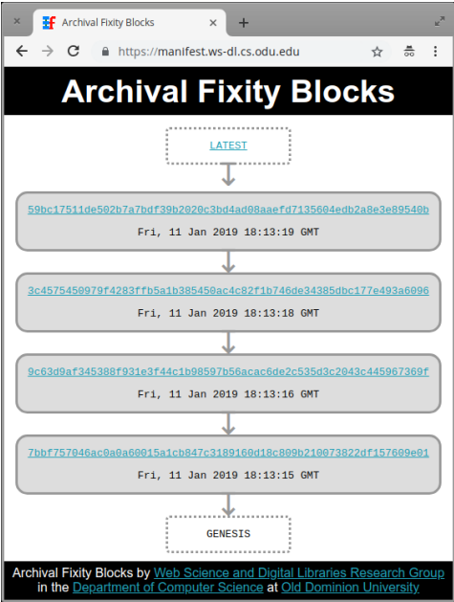
❏ Linking blocks in a chain using their content-addressable hashes provides tamperproofing, and enables discovery of previous blocks.
The figure shows link response header
with appropriate links to navigate
through the chain of blocks.

Slide 20
3. Verifying Fixity of Mementos
❏ Verifying the fixity of a memento in both the Atomic and Block approaches can be
achieved through three common steps:
1. Once a manifest is discovered, TimeGates and/or TimeMaps can be used to retrieve its archived copies available in web archives.
2. Current fixity information is computed by generating a new manifest for the given memento.
3. Then, current hash values in the new manifest is compared with the hashes in the discovered archived manifest

Slide 21
Result Analysis
Observations...

Slide 22
Results
The authors used Python scripts for performing different functions:
❏ generate_atomic()
❏ disseminate_atomic()
❏ verify_atomic()
❏ generate_block()
❏ disseminate_block()
❏ verify_block():
A study on 1,000 mementos from the Internet Archive which are a subset of a larger set of URI-Ms was conducted.
Part of evaluation is measuring the time it takes to generate, disseminate, and verify manifests in the Atomic and Block approaches.
Archival Fixity server is implemented that is responsible for publishing and discovering manifests and blocks.

Slide 23
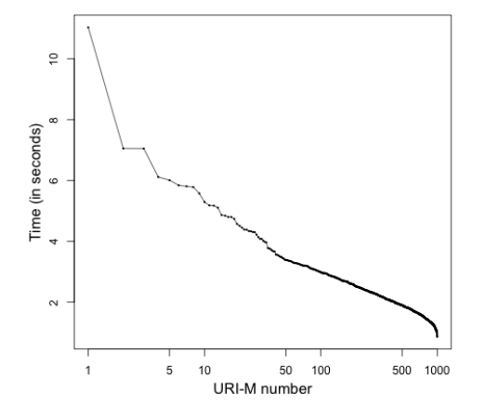
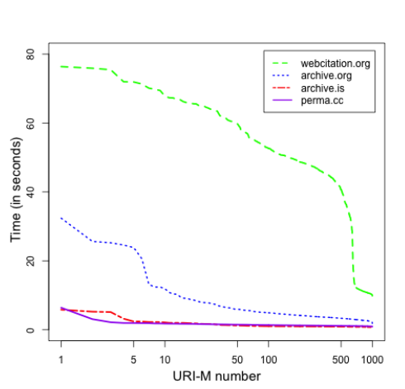
Fig: Generating manifests of mementos
Figure illustrates the distribution of the average time taken to generate manifests.
Fig: Generating manifests of mementos
Figure shows that pushing manifests into webcitation.org (or WebCite) takes much longer time than other archives.

Slide 24
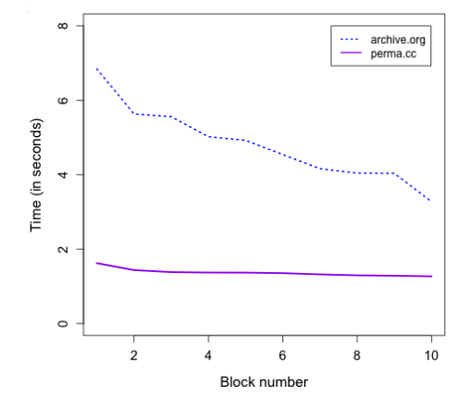
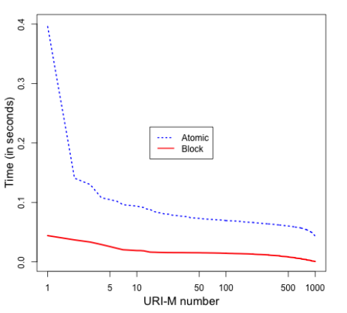
Fig: Disseminating blocks to two archives
The average dissemination time of blocks in archive.org and perma.ccis shown in the above graph.
Fig: Discovering manifests by both approaches
Above graph shows the time required to discover manifests of each memento from the Archival Fixity server.

Slide 25
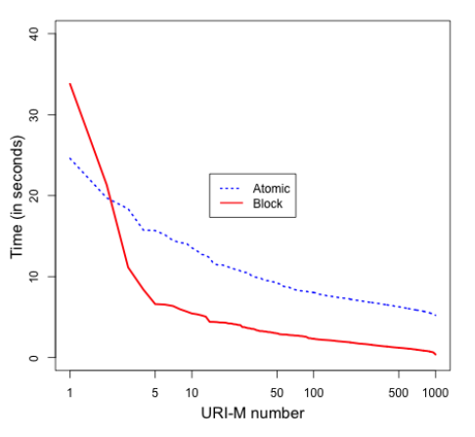
Fig: Verifying mementos by both approaches
The graph illustrates the total time for verifying the fixity of all mementos by both atomic and block approaches.
On average, the verification time of a memento is 6.65 s by the Atomic approach and 1.49 s by the Block approach, so the Block approach performs 4.46X faster than the Atomic approach on verifying the fixity of memento.

Slide 26
Conclusión

Slide 27
❏ The Block approach creates fewer resources in archives and reduces fixity verification time, while the Atomic approach has the ability to verify fixity of archived pages even without involving the Archival Fixity server.
❏ On average, it takes about 1.25X, 4X, and 36X longer to disseminate a manifest to perma.cc, archive.org, and webcitation.org, respectively, than archive.is, while it takes 3.5X longer to disseminate a block to archive.org than perma.cc.
❏ The Block approach performs 4.46X faster than the Atomic approach on verifying the fixity of archived pages.

Slide 28
REFERENCES
[1] 2017. WARC file format. https://www.iso.org/standard/68004.html. ISO 28500:2017
[2] Sawood Alam. 2013. HTTP Mailbox - Asynchronous Restful Communication. Mas- ter’s thesis. Old Dominion University. https://doi.org/10.25777/wh13-fd86
[3] Sawood Alam. 2019. Unified Key Value Store. https://github.com/oduwsdl/ ORS/blob/master/ukvs.md. (January 2019).
[4] Sawood Alam, Michele C. Weigle, and Michael L. Nelson. 2019. MementoMap Framework for Flexible and Adaptive Web Archive Profiling. In Proceedings of the 19th ACM/IEEE Joint Conference on Digital Libraries (JCDL).
[5] Shadi Aljawarneh, Christopher Laing, and Paul Vickers. 2008. Design and experimental evaluation of Web Content Verification and Recovery (WCVR) system: A survivable security system. In Proceedings of the 3rd Conference on Advances in Computer Security and Forensics (ACSF).
[6] Mohamed Aturban and Sawood Alam. 2019. Archival Fixity. https://github. com/oduwsdl/archival-fixity. (2019).
[7] Mohamed Aturban, Sawood Alam, Michael L. Nelson, and Michele C. Weigle. 2019. Archive Assisted Archival Fixity Verification Framework. In Proceedings of the 19th ACM/IEEE Joint Conference on Digital Libraries (JCDL).
[8] Mohamed Aturban, Mat Kelly, Alam Sawood, John Berlin, Michael L Nelson, and Michele C Weigle. 2018. ArchiveNow: Simplified, Extensible, Multi-Archive Preservation. In Proceedings of the 18th ACM/IEEE Joint Conference on Digital Libraries (JCDL).
[9] Mohamed Aturban, Michael L. Nelson, and Michele C. Weigle. 2017. Difficulties of Timestamping Archived Web Pages. Technical Report arXiv:1712.03140.
[10] Mohamed Aturban, Michael L Nelson, and Michele C Weigle. 2018. It is Hard to Compute Fixity on Archived Web Pages. In Proceedings of the Workshop on Web Archiving and Digital Libraries (WADL) held in conjunction with the 18th ACM/IEEE Joint Conference on Digital Libraries (JCDL).
[11] Jefferson Bailey. 2014. Protect Your Data: File Fixity and Data Integrity
[12] Jefferson Bailey, Abigail Grotke, Edward McCain, Christie Moffatt, and Nicholas Taylor. 2017. Web Archiving in the United States: A 2016 Survey. http://ndsa. org/documents/WebArchivingintheUnitedStates A2016Survey.pdf. (Feb- ruary 2017).

Slide 29
THANKS!

